Slide 1
Welcome People
Mean Stack

Slide 2
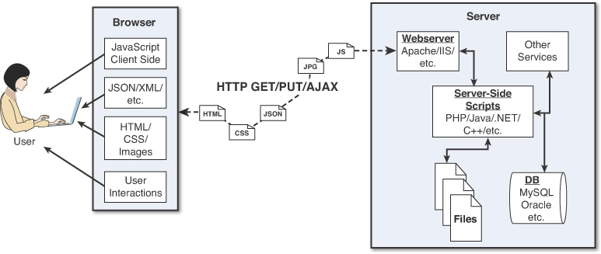
The Traditional Stack

Slide 3
Major Components:
User
Browser
Webserver.
Middle Ware
Backend services.
Data Base
Notes:
The websites may differ in different dimensions but they all tend to have these basic components in one manifestation or the other.

Slide 4
The Browser
Provide communication to and from the webserver
Interpret the data from the server and render it into the view that the user actually sees
Handle user interaction through the keyboard, mouse, touchscreen, or other input device and take the appropriate action
Notes:
The browser plays three roles in the web framework:

Slide 5
Browser-to-Webserver Communication
Hypertext Transfer Protocol (HTTP) is used to define communication between the browser and the webserver. HTTP defines what types of requests can be made as well as the format of those requests and the HTTP response.
HTTPS adds an additional security layer, SSL/TLS, to ensure secure connections by requiring the webserver to provide a certificate to the browser. The user can then determine whether to accept the certificate before allowing the connection.
There are three main types of requests that a browser will make to a webserver:
GET: The GET request is typically used to retrieve data from the server, such as .html files, images, or JSON data.
POST: POST requests are used when sending data to the server, such as adding an item to a shopping cart or submitting a web form.
AJAX: Asynchronous JavaScript and XML (AJAX) is actually just a GET or POST request that is done directly by JavaScript running in the browser. Despite the name, an AJAX request can receive XML, JSON, or raw data in the response.
Notes:
Browser-to-webserver communication consists of a series of requests, using the HTTP and HTTPS protocols.

Slide 6
Rendering the Browser View
The screen that the user actually views and interacts with is often made up of several different pieces of data retrieved from the webserver. The browser reads data from the initial URL and then renders the HTML document to build a Document Object Model (DOM). The DOM is a tree structure object with the HTML document as the root. The structure of the tree basically matches the structure of the HTML document. For example, document will have html as a child, and html will have head and body as children, and body may have div, p, or other elements as children, like this:
Document
+ html
+ head
+ body
+ div
+ p

Slide 7
Rendering the Browser View
The browser interprets each DOM element and renders it to the user’s screen to build the webpage view. The browser often gets various types of data from multiple webserver requests to build a webpage. The following are the most common types of data the browser uses to render the final user view as well as define the webpage behavior:
HTML files: These provide the fundamental structure of the DOM.
CSS files: These define how each of the elements on the page is to be styled, in terms of font, color, borders, and spacing.
Client-side scripts: These are typically JavaScript files. They can provide added functionality to a webpage, manipulate the DOM to change the look of the webpage, and provide any necessary logic required to display the page and provide functionality.
Media files: Image, video, and sound files are rendered as part of the webpage.
Data: Data such as XML, JSON, or raw text can be provided by the webserver as a response to an AJAX request. Rather than send a request back to the server to rebuild the webpage, new data can be retrieved via AJAX and inserted into the webpage via JavaScript.
HTTP headers: HTTP defines a set of headers that the browser can use and client-side scripts to define the behavior of the webpage. For example, cookies are contained in the HTTP headers. The HTTP headers also define the type of data in the request as well as the type of data

Slide 8
The User Interactions
The user interacts with the browser via mice, keyboards, and touchscreens.
A browser has an elaborate event system that captures user input events and then takes the appropriate actions.
Actions vary from displaying a popup menu to loading a new document from the server to executing client-side JavaScript.

Slide 9
Webservers
Handles the Request from the Server.
Out of Box implementations can be only used to serve simple static files.
Usually extended by the means of Server side languages like Java, C++ , C#.
Server side scripts can churn the data them selves or connect to a DB to get the desired data.
Notes:
A webserver’s main focus is handling requests from browsers. As described earlier, a browser may request a document, post data, or perform an AJAX request to get data. The webserver uses HTTP headers as well as a URL to determine what action to take. This is where things get very different, depending on the webserver, configuration, and technologies used.
Most out-of-the-box webservers such as Apache and IIS are made to serve static files such as .html, .css, and media files. To handle POST requests that modify server data and AJAX requests to interact with backend services, webservers need to be extended with server-side scripts.
A server-side script is really anything that a webserver can execute in order to perform the task the browser is requesting.
These scripts can be written in PHP, Python, C, C++, C#, Perl, Java, ... the list goes on and on. Webservers such as Apache and IIS provide mechanisms to include server-side scripts and then wire them up to specific URL locations requested by the browser. This is where having a solid webserver framework can make a big difference. It often takes quite a bit of configuration to enable various scripting languages and wire up the server-side scripts so that the webserver can route the appropriate requests to the appropriate scripts.
Server-side scripts either generate a response directly by executing their code or connect with other backend servers such as databases to obtain the necessary information and then use that information to build and send the appropriate responses.

Slide 10
The Backend Services.
Backend services are services that run behind a webserver and provide data that is used to build responses to the browser.
The most common type of backend service is a database that stores information.
When a request comes in from the browser that requires information from the database or other backend service, the server-side script connects to the database, retrieves the information, formats it, and then sends it back to the browser.
On the other hand, when data comes in from a web request that needs to be stored in the database, the server-side script connects to the database and updates the data.

Slide 11
Moving to the MEAN Stack
In the Node.js-to-AngularJS stack, Node.js provides the fundamental platform for development. The backend services and server-side scripts are all written in Node.js. MongoDB provides the data store for the website but is accessed via a MongoDB driver Node.js module. The webserver is defined by Express, which is also a Node.js module.
The view in the browser is defined and controlled using the AngularJS framework. AngularJS is an MVC framework in which the model is made up of JSON or JavaScript objects, the view is HTML/CSS, and the controller is AngularJS JavaScript code.
The next slide tries to map the traditional components to the mean stack components. Be ware that the following figure is very basic representation and can differ in a lot of cases.

Slide 12
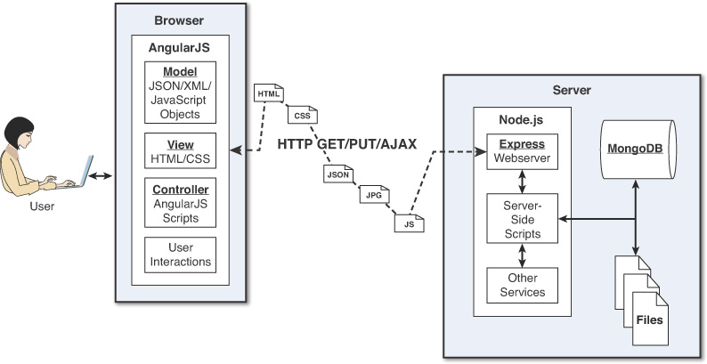
The Mean Stack

Slide 13
Server Side Only Application
Single Page Application
Client
Request
Request Data
Server
HTML Page
Send Data
Control Complete App via JS
Notes:
SPA:
JS controls the whole UI side of the events.
Redender the page.
Update the DOM.
We don’t need to reach out to the server for every single change.
Fetching/Updating the data happens in the background and the main shell never reloads which gives a seamless experience to the user.

Slide 14



Angular JS + Node JS
Render DOM
Router
Request Data
Router
[Express JS]
Route Controllers
Handle Input
Data Base Access
Send Data
Notes:
When we move on to a SPA we all of a sudden see that the JS starts controlling the whole UI scheme of the things.
The Server sends the initial page.
Then the user starts interacting with the page.
We use the Angular Routers to shuffle between the pages and then handle the user inputs and if required re render the DOM. [4,5,6,7]
But whenever Angualr needs to fetch some new Data or to persist any data, it needs to reach out to the server, since Angular is UI only framework. [8]
At the server side in NodeJS world we typically use express JS to define a rotuer which are basically endpoints exposed for the UI to connect via AJAX [9].
Each route would typically have a route controller which would contain the logic to service the request which comes. [10]
We might need to connect to a DB to service the request which incase of the MEAN stack would be MongoDB. [11,12]
And in the end we send the data back to the Angular App asynchronously which inturns parses it and updates the DOM if needed.
Generally speaking there is just one page, all the fetching and persisting of the data happens behind the scenes and hence the user has a desktop like experience.

Slide 15
Node.js
Node.js is a development framework that is based on Google’s V8 JavaScript engine and executes it.
You can write most—or maybe even all—of your server-side code in Node.js, including the webserver and the server-side scripts and any supporting web application functionality. The fact that the webserver and the supporting web application scripts are running together in the same server-side application allows for much tighter integration between the webserver and the scripts. Also, the webserver can run directly on the Node.js platform as a Node.js module, which means it’s much easier than using, say, Apache for wiring up new services or server-side scripts.

Slide 16
Node.js
The following are just a few reasons Node.js is a great framework:
JavaScript end-to-end: One of the biggest advantages of Node.js is that it allows you to write both server- and client-side scripts in JavaScript. There have always been difficulties in deciding whether to put logic in client-side scripts or server-side scripts. With Node.js you can take JavaScript written on the client and easily adapt it for the server and vice versa. An added plus is that client developers and server developers are speaking the same language.
Event-driven scalability: Node.js applies a unique logic to handling web requests. Rather than having multiple threads waiting to process web requests, with Node.js they are processed on the same thread, using a basic event model. This allows Node.js webservers to scale in ways that traditional webservers can’t.
Extensibility: Node.js has a great following and very active development community. People are providing new modules to extend Node.js functionality all the time. Also, it is very simple to install and include new modules in Node.js; you can extend a Node.js project to include new functionality in minutes.
Fast implementation: Setting up Node.js and developing in it are super easy. In only a few minutes you can install Node.js and have a working webserver.

Slide 17
Express
The Express module acts as the webserver in the Node.js-to-AngularJS stack. Because it runs in Node.js, it is easy to configure, implement, and control. The Express module extends Node.js to provide several key components for handling web requests. It allows you to implement a running webserver in Node.js with only a few lines of code.
For example, the Express module provides the ability to easily set up destination routes (URLs) for users to connect to. It also provides great functionality in terms of working with HTTP request and response objects, including things like cookies and HTTP headers.
The following is a partial list of the valuable features of Express:
Route management: Express makes it easy to define routes (URL endpoints) that tie directly to the Node.js script functionality on the server.
Error handling: Express provides built-in error handling for “document not found” and other errors.
Easy integration: An Express server can easily be implemented behind an existing reverse proxy system, such as Nginx or Varnish. This allows you to easily integrate it into your existing secured system.
Cookies: Express provides easy cookie management.
Session and cache management: Express also enables session management and cache management.

Slide 18
MongoDB
MongoDB is an agile and very scalable NoSQL database. The name Mongo comes from the word “humongous,” emphasizing the scalability and performance MongoDB provides. It is based on the NoSQL document store model, which means data is stored in the database as basically JSON objects rather than as the traditional columns and rows of a relational database.
MongoDB provides great website backend storage for high-traffic websites that need to store data such as user comments, blogs, or other items because it is quickly scalable and easy to implement.
Node.js supports a variety of database access drivers, so the data store can easily be MySQL or some other database. However, the following are some of the reasons that MongoDB really fits in the Node.js stack well:
Document orientation: Because MongoDB is document oriented, data is stored in the database in a format that is very close to what you deal with in both server-side and client-side scripts. This eliminates the need to transfer data from rows to objects and back.
High performance: MongoDB is one of the highest-performing databases available. Especially today, with more and more people interacting with websites, it is important to have a backend that can support heavy traffic.
High availability: MongoDB’s replication model makes it very easy to maintain scalability while keeping high performance.
High scalability: MongoDB’s structure makes it easy to scale horizontally by sharing the data across multiple servers.

Slide 19
AngularJS
AngularJS is a client-side framework developed by Google. It provides all the functionality needed to handle user input in the browser, manipulate data on the client side, and control how elements are displayed in the browser view. It is written in JavaScript, with a reduced jQuery library. The theory behind AngularJS is to provide a framework that makes it easy to implement web applications using the MVC framework.
Other JavaScript frameworks could be used with the Node.js platform, such as Backbone, Ember, and Meteor. However, AngularJS has the best design, feature set, and trajectory at this writing. Here are some of the benefits AngularJS provides:
Data binding: AngularJS has a very clean method for binding data to HTML elements, using its powerful scope mechanism.

Slide 20
Angular JS continued…
Extensibility: The AngularJS architecture allows you to easily extend almost every aspect of the language to provide your own custom implementations.
Clean: AngularJS forces you to write clean, logical code
Reusable code: The combination of extensibility and clean code makes it very easy to write reusable code in AngularJS. In fact, the language often forces you to do so when creating custom services.
Support: Google is investing a lot into this project, which gives it an advantage over similar initiatives that have failed.
Compatibility: AngularJS is based on JavaScript and has a close relationship with jQuery. This makes it easier to begin integrating AngularJS into your environment and reuse pieces of your existing code within the structure of the AngularJS framework.

Slide 21
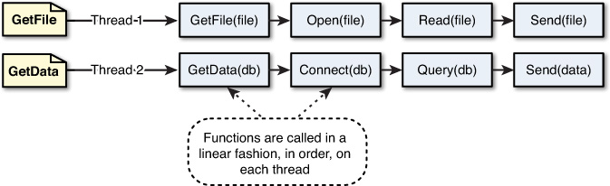
Comparing Callbacks and Threaded Models.
In the traditional threaded web model, a request comes to a webserver and is assigned to an available thread. The handling of work for that request continues on that thread until the request is complete and a response is sent.
The following figure illustrates the threaded model processing two requests, GetFile and GetData. The GetFile request opens the file, reads the contents, and then sends the data back in a response. All this occurs in order on the same thread. The GetData request connects to the database, queries the necessary data, and then sends the data in the response.

Slide 22
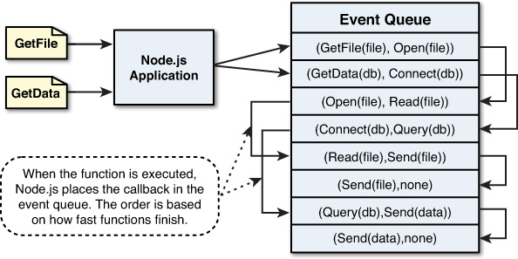
Comparing Callbacks and Threaded Models.
Instead of executing all the work for each request on individual threads, Node.js adds work to an event queue and then has a single thread running an event loop pick it up. The event loop grabs the top item in the event queue, executes it, and then grabs the next item. When executing code that is longer lived or has blocking I/O, instead of calling the function directly, it adds the function to the event queue along with a callback that will be executed after the function completes. When all events on the Node.js event queue have been executed, the Node.js application terminates.
The below fiure illustrates how Node.js handles the GetFile and GetData requests. It adds the GetFile and GetData requests to the event queue. It first picks up the GetFile request, executes it, and completes by adding the Open() callback function to the event queue. Then it picks up the GetData request, executes it, and completes by adding the Connect() callback function to the event queue. This continues until there are no callback functions to be executed.

Slide 23
Comparing Callbacks and Threaded Models.
To help you understand how events work in Node.js compared to traditional threaded webservers, consider an example of having different conversations with a large group of people at a party. You are acting the part of the webserver, and the conversations represent the work necessary to process different types of web requests. Your conversations are broken up into several segments with different individuals. You end up talking to one and then another, then back to the first and then a third, back to the second, and so on.
The conversation example works well because it has many similarities to webserver processing. Some conversations end quickly (for example, a simple request for a piece of data in memory). Others are broken up in several segments that go back and forth between individuals (much like the more complex server-side conversations). Still others have long breaks while waiting for the other person to respond (like blocking I/O requests to the file system, database, or remote service).
Using the traditional webserver threading model in the conversation example sounds great at first because each thread acts like a clone of you. The threads/clones can talk back and forth with each person, and it almost seems like you can have multiple conversations simultaneously. There are two problems with this model.

Slide 24
The first problem is that you are limited by the number of clones. If you have only five clones, then to talk with a sixth person, one clone must completely finish its conversation. The second problem is that there is a limited number of CPUs/brains that the threads/clones must share. This means the clones sharing the same brain have to stop talking/listening while other clones are using the brain. You can see that there really isn’t a very big benefit to having clones when they freeze while the other clones are using the brain.
The Node.js event model acts more similarly to a real-life conversation than does the traditional webserver model. First of all, Node.js applications run on a single thread, meaning there is only one of you—no clones. Each time a person asks you a question, you respond as soon as you can. Your interactions are completely event driven; you move naturally from one person to the next. Therefore, you can have as many conversations going on at the same time as you like and bounce between individuals. Second, your brain is always focused only on the person you are talking to since you aren’t sharing it with clones.
So what happens when someone asks you a question that you have to think about for a while before responding? You can still interact with others at the party while trying to process that question in the back of your mind. That processing may impact how fast you interact with others, but you are still able to communicate with several people while processing the longer lived thought. This is similar to how Node.js handles blocking I/O requests using the background thread pool. Node.js hands blocking requests over to a thread in the thread pool so that they have minimal impact on the application-processing events.

Slide 25
Course Overview : ANGULAR Part [UI]
Introducing Typescript
Typescript Concepts.
Angular Components
Angular Services.
Angular Modules.
Angular Routing.
Angular Styling
Angular Directives and Pipes

Slide 26
What does the section cover:
Brief history of JavaScript
Understanding the JS types.
Advantages and disadvantages of JavaScript.
Understanding why TypeScript

Slide 27
Brief history of JavaScript
What was it developed for ????

Slide 28
Questions ??
Where did JS come from ??
What was the motivation to create it ??
How was it standardized ??

Slide 29
Where JS came From??
Netscape Communications – May 1995
Brendan Eich wrote a prototype in 10 days.
Originally named Mocha and LiveScipt, later renamed.
First released in Netscape 2.0, beta 3 in December 1995.
It was initially developed to some scripting around the webpages and some DOM manipulations etc.

Slide 30
Motivations For JavaScript
The web needed a glue language.
Netscape was at war with Microsoft and they wanted to develop the browser which can do more than just render the webpages.
Designed to save some time and bandwidth by doing the client side input validations.
Was designed to be used by amateurs and advanced users alike.
Was designed to be malleable.

Slide 31
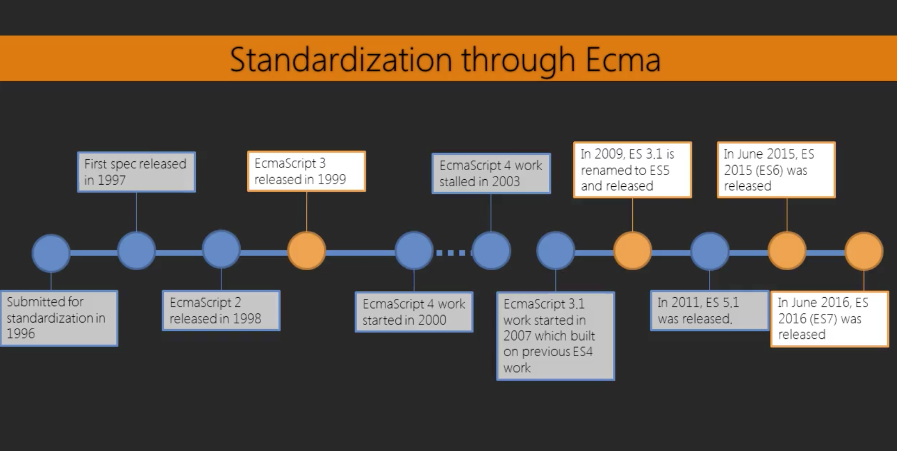

Slide 32










Array functions
.isArray()
.every()
.forEach()
.indexOf()
.lastIndexOf()
.some()
.map()
.reduce()
.filter()

Slide 33
Everything Is an Object? [Well Almost]
PRIMITIVES
NUMBER
STRING
BOOLEANS
UNDEFINED
NULL
EVERYTHING ELSE:
ARRAYS
FUNCTIONS
OBJECTS
DATES
WRAPPERS FOR NUMBERS, STRINGS, BOOLEANS
DATES
REGULAR EXPRESSIONS
IS AN OBJECT ….
ACCESSED BY VALUE
ACCESSED BY REFERENCE

Slide 34
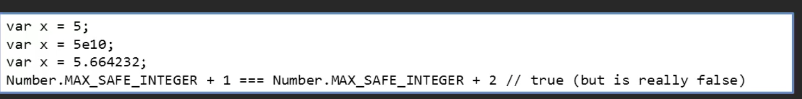
numbers
Numbers in JS have 64-bit floating point precision.
There is no ‘integer’ type.
After a certain value, integers are “unsafe” and are approximated floating point.
Special values : Infinity, -Infinity and NaN

Slide 35
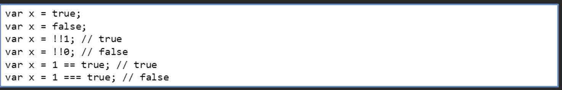
Booleans
Booleans have a value of true or false.
But everything in JS has a truthy and falsie values.
In comparisons, equality can based off of coerced values [==].
For identity comparison always use the === operator.

Slide 36
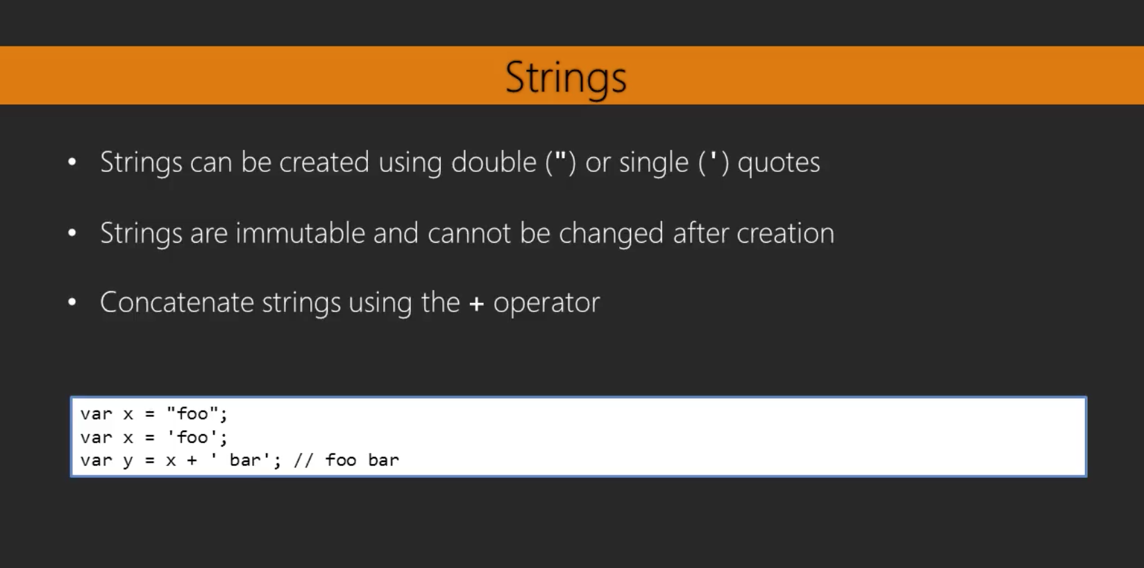

Slide 37
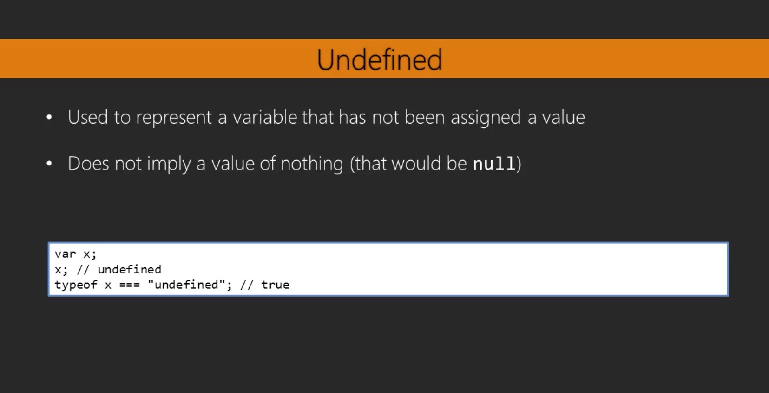

Slide 38
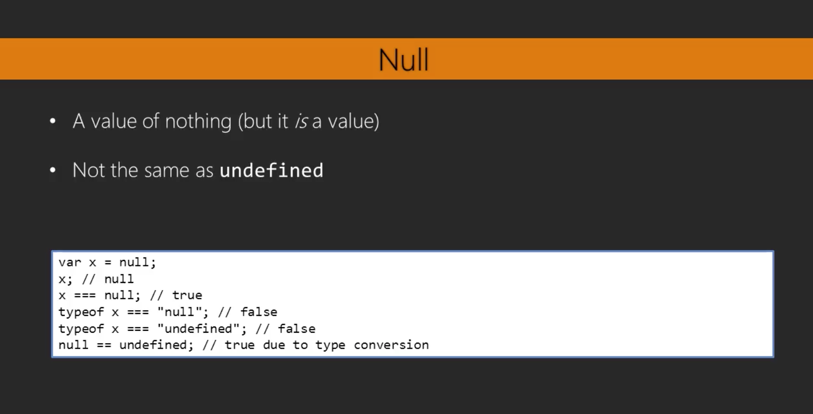

Slide 39
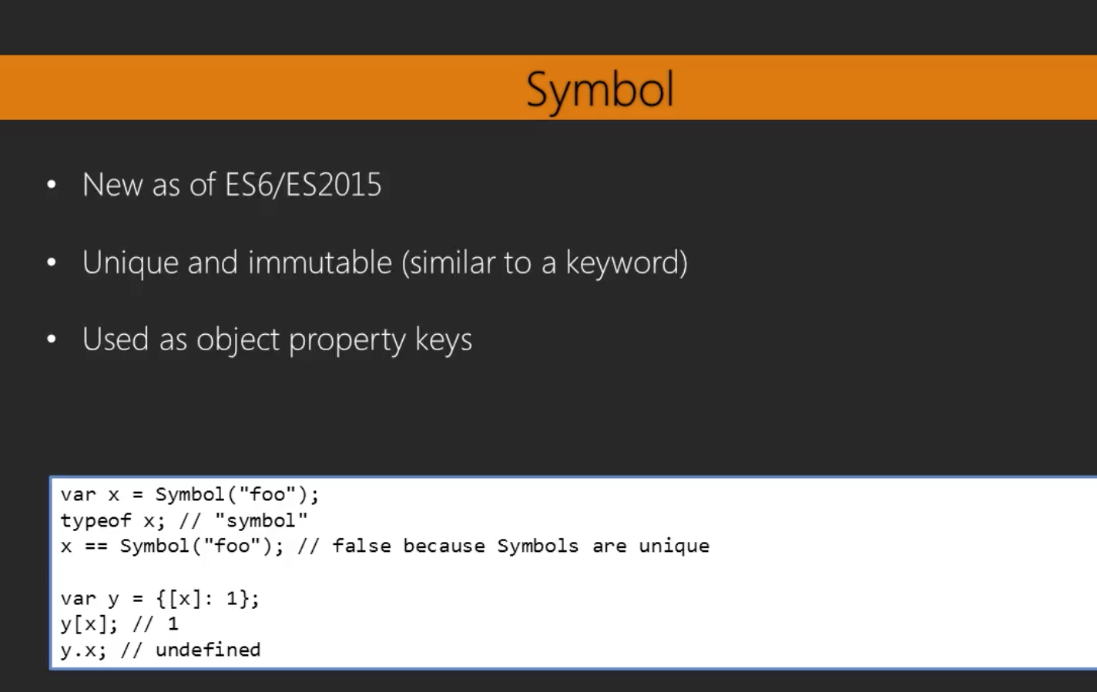

Slide 40
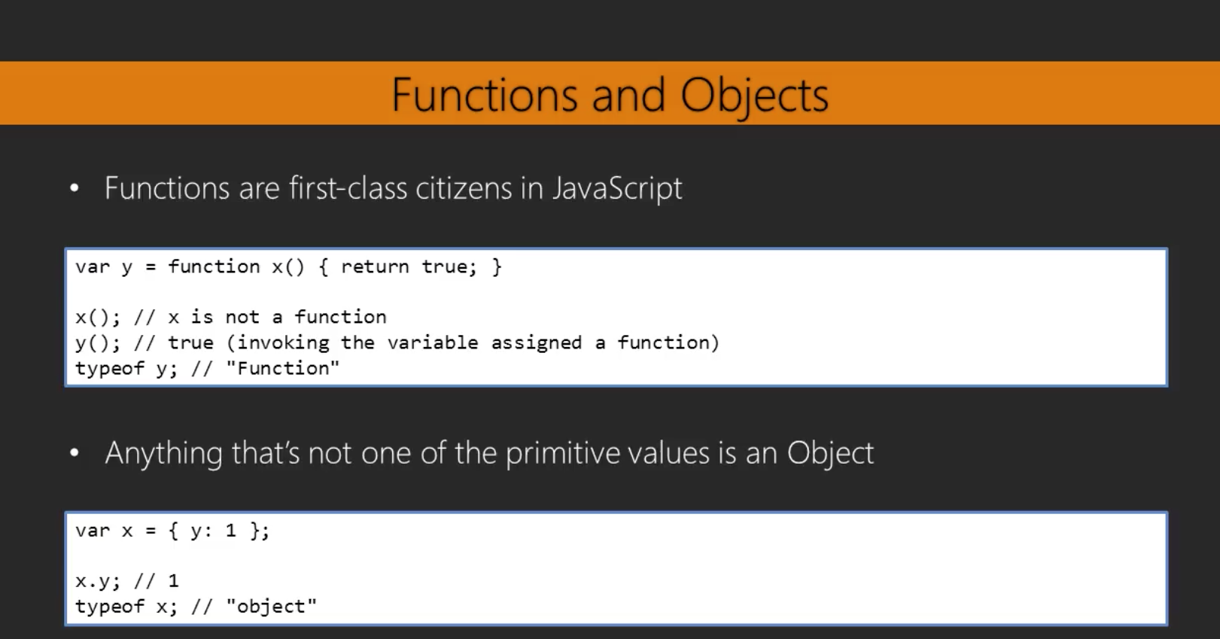

Slide 41

ES5

Slide 42
Strict Mode
Use strict or “use strict” at the first line of the file or function.
Can BREAK working code.
More stringent checking.
Enables ES5 features.
Variables must be declared.
Functions defined only at the top level scope.
“this” is undefined at the global level.
Throws an error when construct is called with “new” keyword.
Cannot use the same function parameter twice.

Slide 43
Falsey
Type | Results
null | FALSE
undefined | FALSE
Number | if 0 or NaN, FALSE
String | if length = 0, FALSE
Object | TRUE

Slide 44
FOR EACH
let junk =
[1, 2, 3, 4,
'Alpha',
5, {name:
'Jason'}];
let letters
= ['A',
'B', 'C',
'D',
'E',
'F', 'G', 'H',
'I', 'J',
'K'];
let nums = [1, 2, 3, console.log(nums);
4, 5, 6,
7, 8, 9,
10, 11, 12, 13,
14, 15, 16,
17, 18, 19, 20];
// forEach iterates over
// break out
the array,
once
for each
element,
but there
is no way to
nums.forEach(function (elem, console.log(index + ': ' +
});
index,
arr) {
elem);

Slide 45
MAP
let junk =
[1, 2, 3, 4,
'Alpha',
5, {name:
'Jason'}];
let letters
= ['A',
'B', 'C',
'D',
'E',
'F', 'G', 'H',
'I',
'J',
'K'];
let nums = [1, 2, 3, console.log(nums);
// map iterates over
4, 5, 6,
7, 8, 9,
10, 11, 12, 13,
14, 15,
16, 17,
18, 19, 20];
all of
the elements
and returns
a new array
with
the same
// number of elements
let nums2 = nums.map((elem) console.log(nums2);
=> elem * 2);

Slide 46
FILTER
let junk =
[1, 2, 3, 4,
'Alpha',
5, {name:
'Jason'}];
let letters
= ['A',
'B', 'C',
'D',
'E',
'F', 'G', 'H',
'I', 'J',
'K'];
let nums = [1, 2, 3, console.log(nums);
4, 5, 6,
7, 8, 9,
10, 11, 12, 13,
14, 15, 16,
17, 18, 19, 20];
// filter iterates over
// that pass the test
the array
and returns
a new array
with
only
the elements
let nums3 = nums.filter((elem) console.log(nums3);
=> !!(elem
% 2));

Slide 47
REDUCE
let junk =
[1, 2, 3, 4,
'Alpha',
5, {name:
'Jason'}];
let letters
= ['A',
'B', 'C',
'D',
'E',
'F', 'G', 'H',
'I',
'J',
'K'];
let nums = [1, 2, 3, console.log(nums);
4, 5, 6,
7, 8, 9,
10, 11, 12, 13,
14, 15, 16, 17,
18, 19, 20];
// reduce iterates over
the array
passing the
previous
value
and the
current
// element it is up to you
what the reduction
does,
let's
concatenate
the strings
let letters2 = letters.reduce((previous, console.log(letters2);
current)
=> previous
+ current);
// | reduceRight | does the same but goes from right to left
let | letters3 = | letters.reduceRight((previous,current)=> |  | previous | + | current);
console.log(letters3);

Slide 48

EVERY
let junk =
[1, 2, 3, 4,
'Alpha',
5, {name:
'Jason'}];
let letters
= ['A',
'B', 'C',
'D',
'E',
'F', 'G', 'H',
'I', 'J',
'K'];
let nums = [1, 2, 3, console.log(nums);
4, 5, 6,
7, 8, 9,
10, 11, 12, 13,
14, 15, 16,
17, 18, 19, 20];
// every makes sure that
let isEveryNumbers =
all the elements match
the expression
junk.every((elem)
=> typeof
elem === 'number');
console.log('Are all members
of junk
numbers:
' + isEveryNumbers);

Slide 49


JSON
JSON strings must be double quote
key/value pairs
key is any valid JS string value is an valid JS data type
.stringify() - converts object to JSON string
.parse() - converts JSON string to object

Slide 50

ES6 (ES2015)

Slide 51









ES6 aka ES2015
let
const
Classes
Template strings
Promises
Arrow functions
Using ES6 today
for-of

Slide 52
LET
let
Let allows us to create block level scoped variables in JS.
They live and Die within their curly braces.
Best practices state that we should use let instead of var.

Slide 53
let
// let allows us to create
// they live and die within
let val = 2;
block the
scoped variables curly braces
console.info(`val = ${val}`);
{
let val = 59;
console.info(`val = ${val}`);
}
console.info(`val = ${val}`);

Slide 54
const
const creates a variable that can't be changed
best practice is to make any variable that should not change a constant
does not apply to object properties or array elements

Slide 55
const
const name = 'Troy';
console.info(`My name is ${name}`);
// the line below triggers a type error
name = 'Miles';

Slide 56
Template strings
Defined by using opening & closing back ticks
Templates defined by ${JavaScript value}
The value can be any simple JavaScript expression Allows multi-line strings (return is pass thru)

Slide 57
Template strings
let state
let city
= 'California';
= 'Long Beach';
console.info(`This weekend's workshop is in ${city}, ${state}.`);
// template strings can run simple expressions like addition
let cup_coffee = 4.5;
let cup_tea = 2.5;
console.info(`coffee: $${cup_coffee} + tea: $${cup_tea} = $$
{cup_coffee + cup_tea}.`);
// they can allow
us to create multi-line strings is line #1.
this is line #2.`);
console.info(`This

Slide 58
Arrow lambda functions
let anon_func =
return num1 +
};
function
num2;
(num1, num2) {
console.info(`Anonymous func: ${anon_func(1, 2)}`);
let arrow_func = (num1, num2) => num1 + num2;
console.info(`Arrow func: ${arrow_func(3, 4)}`);

Slide 59
For of
for of lets us iterate over an array
.entries() gives us the index and the element with destructuring we can use as variables unlike forEach, continue and break work
break stop the loop
continue stops the current iteration

Slide 60
For of
for (let elem of pirateArray) { console.info(elem);
}
// if we want the element and its index we can get it too
for
(let [index, elem] of pirateArray.entries()) {
if (index === 5) {
break;
}
console.info(`${index}. ${elem}`);
}
forEach, continue and break work
// unlike
for (let [index, elem]
of pirateArray.entries()) {
if (index === 5) {
continue;
}
console.info(`${index}. ${elem}`);
}

Slide 61
classes
// class must exist before usage
class Animal { constructor(name) {
this.name = name;
this.legs = 2;
}showNameAndLegs() {
console.info(`${this.name} has ${this.legs} legs.`);
}
}
var myBird = new Animal("Bird"); myBird.showNameAndLegs();

Slide 62
PROMISE
function sometimesWorks() {
// note:
// the
all this function does is return a promise
promise returns immediately to the caller
return new
Promise(
(resolve, reject) {
function
// number
let delay = getRandomNum(1000,
of milliseconds to delay
3000);
setTimeout(function(){
// whether
let worked =
it is successful or not
!!Math.floor(getRandomNum(0,
2));
if(worked){
resolve('It worked!');
} else {
reject('It failed');
}
}, delay);
});
}

Slide 63
PROMISE
sometimesWorks().then(
// if it is successful, it will come here
function (data) { console.info(data);
},
// if it fails
(err)
it will come here
{
function
console.info(err);
}
);
console.info('Back from promise land');

Slide 64




Difference between var and let
var is scoped to blocks and let is scoped to functions
let is scoped to blocks and var is scoped to functions
let allows you to create a constant, var is for variables
Nothing, let is the same as var

Slide 65
Default parameters
Automatically assign a value to undefined parameters
Always taken from left to right

Slide 66

Default value example
1 var add = (x=1, y=2) => x + y; 2
console.info(add(10));

Slide 67
WhY IS TypeScript a language for Angular applications
We don’t have languages for developing Java or C# applications do we ?

Slide 68
Problem with JavaScript
No Modules , only files.
No linkages.
No Static Checking.
Has no compilation step, and so is executed on the fly.
Very Hard to Refactor.

Slide 69
What’s good with JavaScript
It’s everywhere.
Huge amount of libraries.
Pretty flexible.
Huge community support.

Slide 70
WHY was typescript chosen For Angular development
TypeScript supports types.
Great IDE support is one of TypeScript’s main advantages.
Angular is bundled with type definitions files, so IDEs perform type checking while using the Angular API and offer context-sensitive help right out of the box.
TypeScript follows the ECMAScript 6 and 7 specifications .
The generated JavaScript code is easy to read, and it looks like hand-written code.
Most of the code samples in the Angular documentation, articles, and blogs are given in TypeScript(see https://angular.io/docs).

Slide 71

TypeScript

Slide 72

2.0 licensed

Slide 73
Benefits of typescript
Compilation
Strong Typing
Integration with popular JavaScript libraries
Encapsulation
Private and public member variables.
Super Set of the JS.

Slide 74
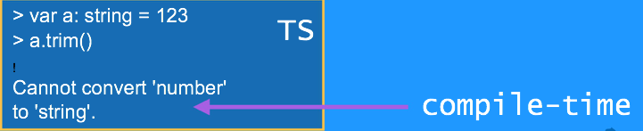
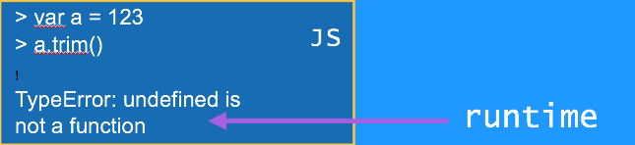
Compilation

Slide 75
Transpilers
Web browsers don’t understand any language but JavaScript.
If the source code is written in TypeScript, it has to be transpiled into JavaScript before you can run it in the browser’s or a standalone JavaScript engine.
Transpiling means converting the source code of a program in one language into source code in another language.
Many developers prefer to use the word compiling, so phrases like “TypeScript compiler” and “compile TypeScript into JavaScript” are also valid.

Slide 76
Strongly Typed
var test = ”something"; test = true; test = function(a, b) { return a + b; }
PLAIN JS
var test: string = ”something";
test = 1;
test = function(a, b) {
return a + b;
}
TS
error TS2011: Build: Cannot convert 'number' to 'string'. error
TS2011: Build: Cannot convert '(a: any, b: any) => any' to 'string'.

Slide 77
TYPE SCRIPT IS STRONGLY TYPED
Once a variable is declared to of a certain type, then we can only assign the value of the specified datatypes.
Ensures that the code behaves in an expected manner.
Can be extended to the objects, classes and function declarations and invocations.
Take the documentation to the IDEs and let compiler generate errors.
TS proposes a very simple syntax to ensure predictability.

Slide 78
Integration With Popular JS Libraries.
What about the Existing Libraries that we have , how can I integrate with those ?
Typescript easily integrates with the existing libraries using the definition files
Typically in .t or .ts extensions.
Can be created for any library written in JS.
Provides the same META DATA that is provided by any regular typescript file.
That means TS can be use to code the Angualr 1.x applications as well.
https://github.com/DefinitelyTyped/DefinitelyTyped

Slide 79
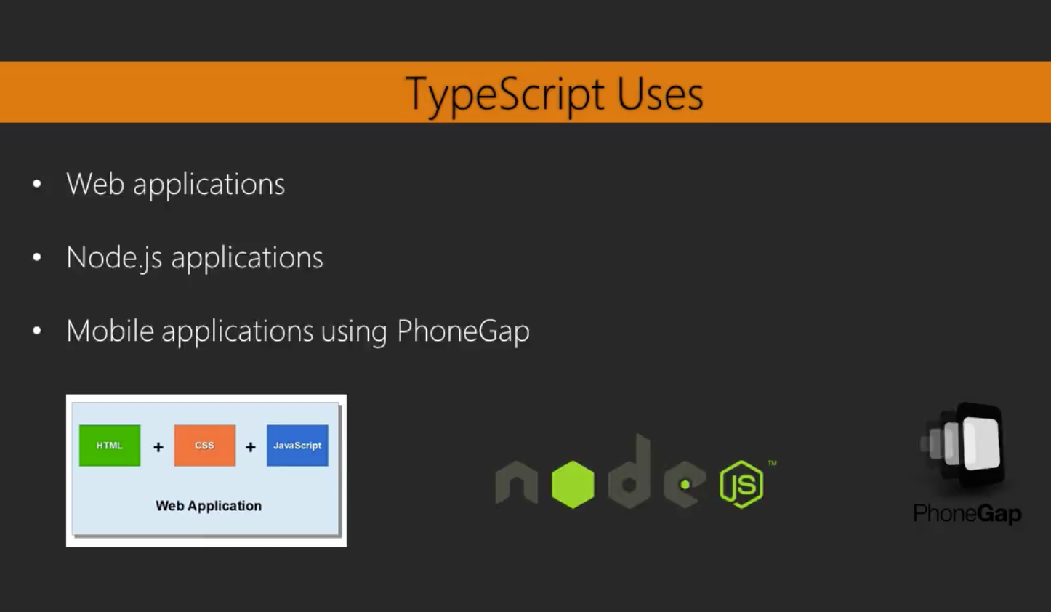

Slide 80
SECTION OBJECTIVES
IDEs.
Setting up the environment with the Typescript tranpilers.

Slide 81
Installing and using the TypeScript compiler
The TypeScript compiler is itself written in TypeScript.
You’ll use Node.js’s npm package manager to install the compiler.
npm install -g typescript
Code written in TypeScript has to be transpiled into JavaScript so web browsers can execute it.
TypeScript code is saved in files with the .ts extension
tsc <filename>.ts would compile a file written as <filename>.ts to <filename>.js
tsc --sourcemap <filename>.ts would generate the source map for the debugging.
Notes:
"compilerOptions": { "target": "es5", "module": "commonjs", "emitDecoratorMetadata": true, "experimentalDecorators": true, "rootDir": ".", "outDir": "./js" } }

Slide 82
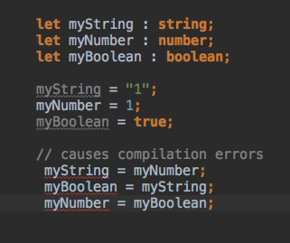
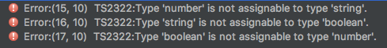
Type SCRIPT IS STONGLY TYPED
The Type Script syntax for declaring the type of a variable is to include a colon (:), after the variable name, and then indicate its type

Slide 83
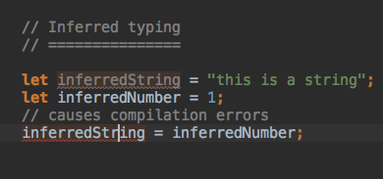
INFERRED TYPING
In the cases where the developer chooses not to define the types.
Looks at the first usage of the variable initialization and assumes it to be having the same type in the rest of the code.

Slide 84
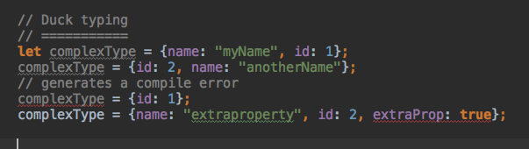
Duck TYPING
f it looks like a duck, and quacks like a duck, then it probably is a duck.
Helps Introducing strong typing to our code without the need of explicit typing.

Slide 85
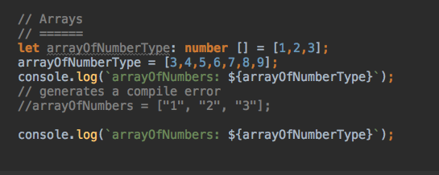
Additional Types : Arrays AND ENUMS
TS introduces two added types : Arrays and Enums.

Slide 86
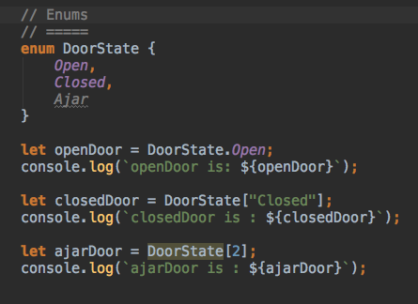
Additional Types : Arrays AND ENUMS
Enums : Borrowed From languages like Java and C#
Used to Define a collection of constants.

Slide 87
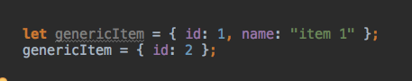
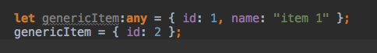
Flexibility Compromised ?? : Enter “ANY”
JS Allowed
TS Prohibits
Enter Any
Specifying that an object has a type of any in essence relaxes the compiler's strict type checking.
Should be used sparingly since can lead to the same mess.

Slide 88
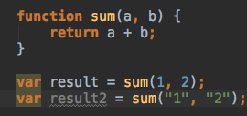
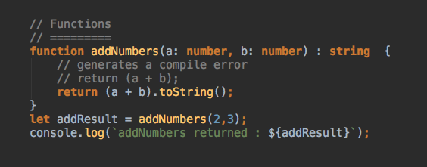
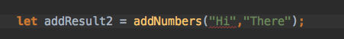
Functions: Strongly Typing Function Params
JS Allowed
Unpredictible
TS Strong Typing
Non Conforming Invocation

Slide 89
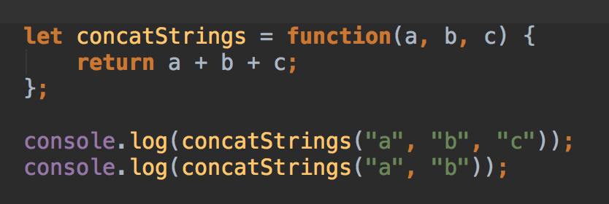
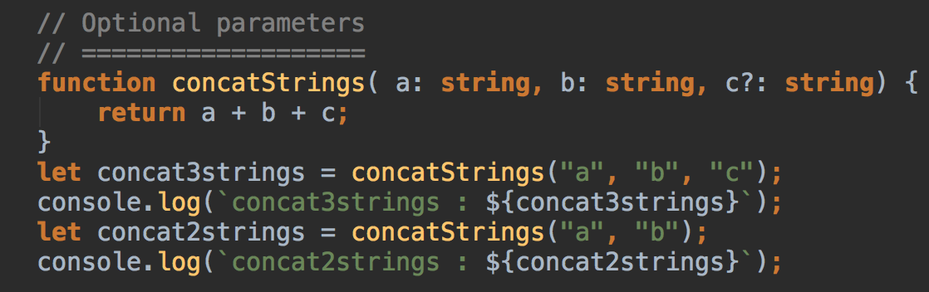
Functions: Optional Parameters
JS Allowed
Unpredictible
TS Optional Params
Non Conforming Invocation

Slide 90
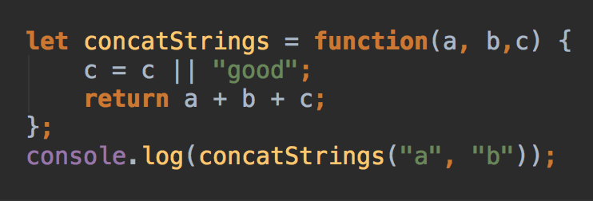
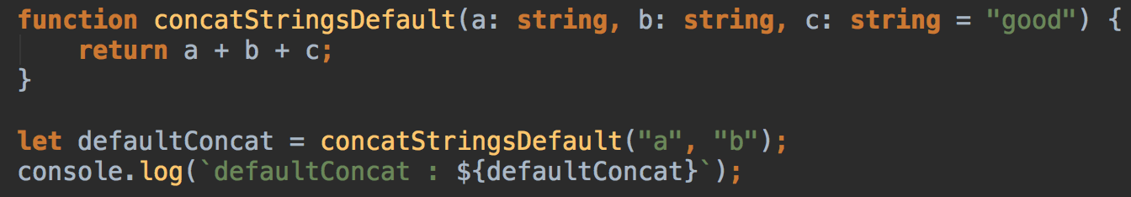
Functions: DEFAULT Parameters
JS Allowed
Unpredictable
TS Default Param Values

Slide 91
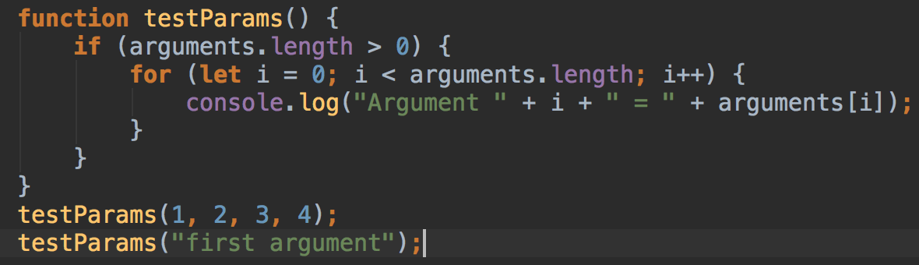
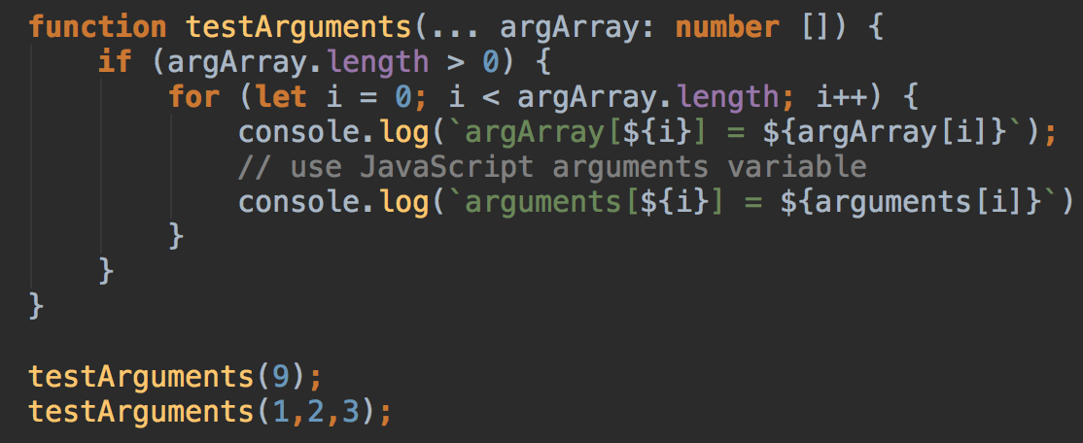
Functions: arguments object
JS Allowed
TS Default Param Values

Slide 92
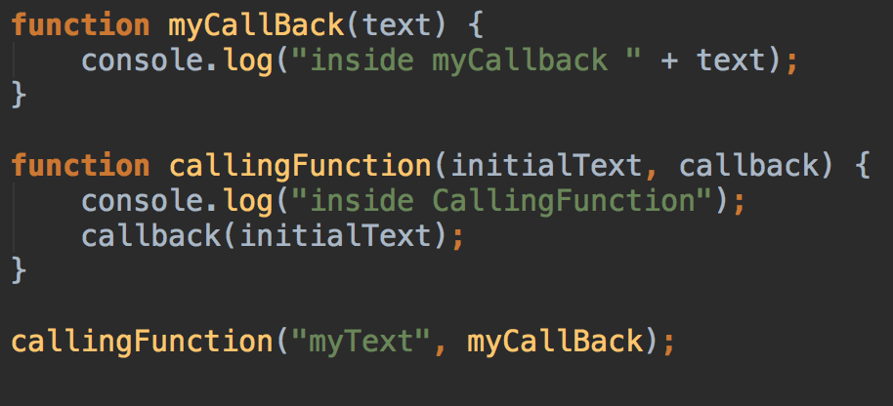
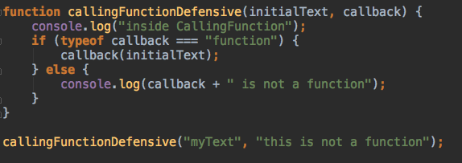
Functions: Callbacks
Defensive JS Progrmammer Approach
Signature feature of the JS.
Type Checking
JS Allowed
BUT Erroneous Invocation quite Possible.
Results in an Error

Slide 93
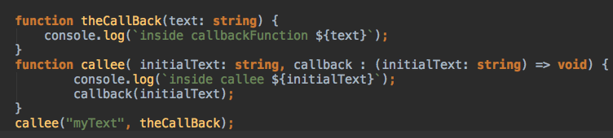
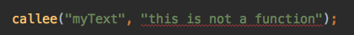
Functions: Callbacks
Typescript Enforces the strong typing for the function signatures as well.
A function signature introduces the fat arrow syntax to document how the function should look like.
Not Allowed
Any Invocation with Function Definition Non Conforming to the type specified not Allowed

Slide 94
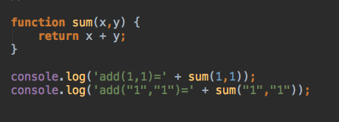
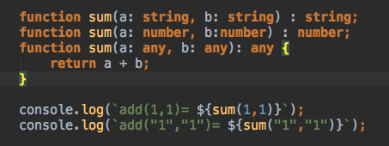
Functions: Overloading
JS Allowed calling the same function with different argument types with no issues hence no overloading required,
Since with TS we now specify the inputs, we need to write previous code with a specific syntax to indicate multiple function signature for the same function

Slide 95
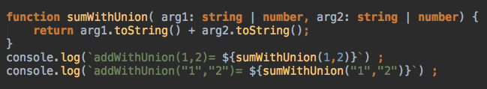
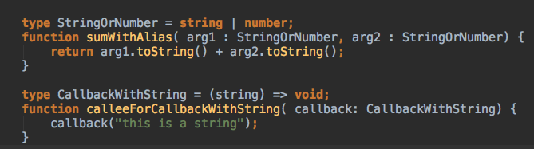
Functions: union types
TS 1.4 enables us to specify the union types which is to combine various types with the pipe symbol.
We are also able to define an alias for a type, a union type, or a function definition. Type aliases are denoted by using the type keyword.

Slide 96
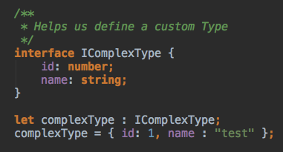
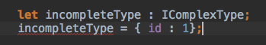
Interfaces: custom types
Interfaces are contracts that the object said to be implementing, should abide by. It is a mechanism to ensure an object defines a set of properties and methods.
Variable type defined to be of the custom type IComplexType with two strongly typed properties. Any variable with that custom type should have these two properties.
Non Conforming object definitions would be flagged.
Interfaces are a compile-time language feature of TS , and the compiler does not generate any JavaScript code from interfaces that you include in your TypeScript projects. Interfaces are only used by the compiler for type checking during the compilation step.

Slide 97
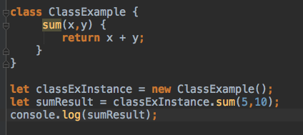
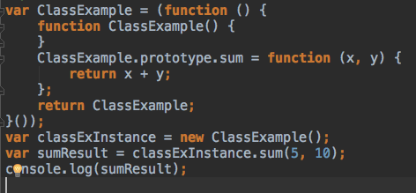
Encapsulation: Bundling the MeThods
A language mechanism for restricting direct access to some of the object’s components.
A language construct that facilitates the bundling of data with the methods (or other functions) operating on that data.
Type Script
JavaScript

Slide 98
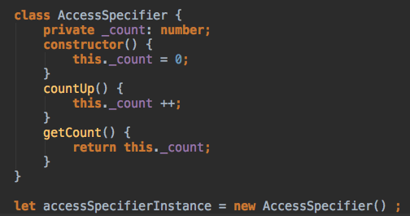
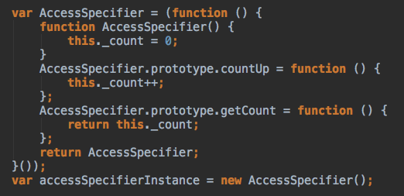
Encapsulation: Bundling the MeThods
Type Script
JavaScript

Slide 99
Adding class metadata with annotations
@Component({ // Include here the selector (the name) to identify // the component in the HTML document. // Provide the template property with the // HTML fragment to render the component. // Component styling also goes here. }) class HelloWorldComponent { // The code implementing the component's // application logic goes here. }
There are different definitions of the term metadata. The popular definition is that metadata is data about data..
TypeScript decorators provide a way to add metadata to your code. In particular, to turn a TypeScript class into an Angular component, you can annotate it with metadata. Annotations start with an @ sign.
To turn a TypeScript class into an Angular UI component, you need to decorate it with the @Component annotation.
Angular will internally parse your annotations and generate code that adds the requested behavior to the TypeScript class.
When you use annotations, there should be an annotation processor that can parse the annotation content and turn it into code that the runtime (the browser’s JavaScript engine) understands. In the context of this book, Angular’s compiler ngc performs the duties of the annotation processor

